Slide 1

Modeling of Circulating Cancer Cells
By : John Quinn
Advising Professor: Mahsa Dabagh

Slide 2
Introduction
Presenter / Researcher : John Quinn
Advising Professor: Mahsa Dabagh
All Project Files made Available for Free use and Modification at:
https://github.com/jqstudy2019/lammpsfiles
Notes:
Speaking Notes
Refrences

Slide 3
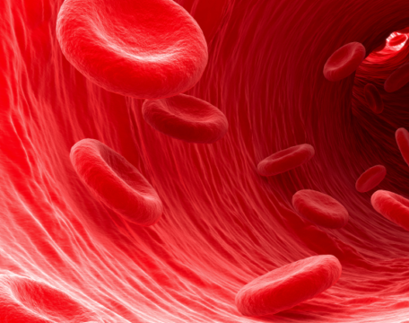
Background –Blood Biology
Normally, Almost half of the blood’s volume is made up of RBC’s
Of the Remaining Volume Water makes up the majority
Red Blood Cells (RBC) Main Functions are to:
Carry Oxygen to the Cells
Carry Carbon Dioxide away from cells ; to the lungs
While RBC’s are different In key ways from other body cells . .
( Lacks Nucleus ; Free Floating ; Etc.)
. . they still retain many structural components of other cells
Importantly ->Lipid Bilayer Outer Membrane and Cytoskeletal Matrix Within
Notes:
Speaking Notes
References
Facts About Blood and Blood Cells. (2019, August 15). Retrieved April 16, 2020, from https://www.mskcc.org/cancer-care/patient-education/facts-about-blood-and-blood-cells
ADD MY OWN RBC PIC TOO
Background
Hestericová , M. R. (2018). Artist's impression of red blood cells flowing through a blood vessel.
Retrieved from https://physicsworld.com/a/shape-shifting-red-blood-cells-respond-to-shear-
forces/

Slide 4
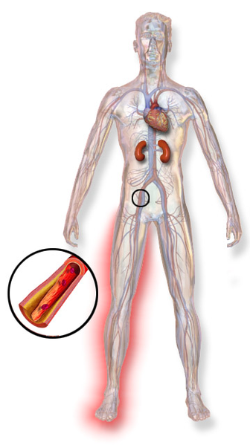
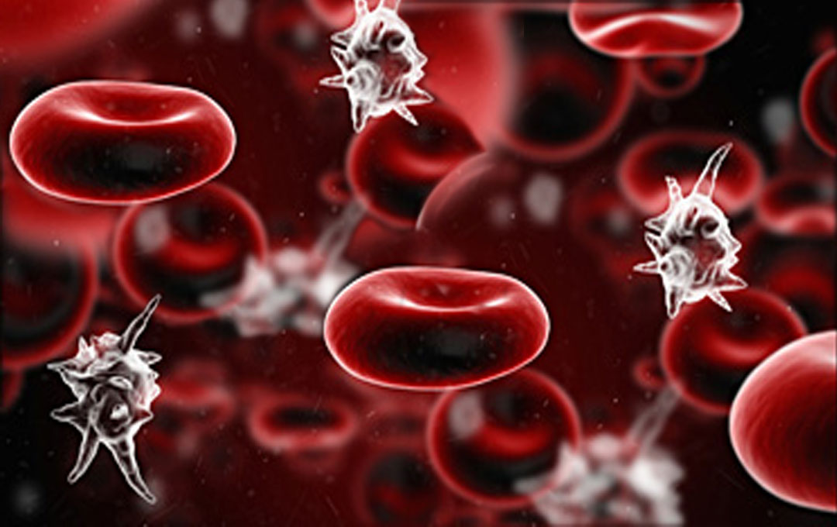
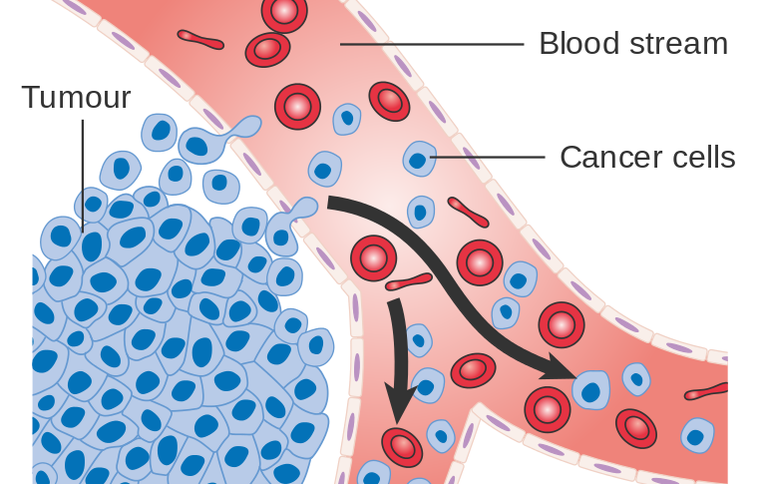
Background – Why Simulate Blood?
There are many Aliments that are Bloodborne in Origin:
Metastatic Cancer – Cancer Cells that break off larger tumors and travel in the blood flow
Vascular Disease – Such as Myocardial Infarctions and PAD
-Mainly Caused by build up in vessels
Sepsis – Bacterial Infection of the Blood ; Potentially Deadly
Notes:
Speaking Notes
Simulate because we don’t want to have to test these conditions on people so if can limit by simulation good
RBC’s constitute ~50% of volume with most of rest being water; thus largest contributor to mecahincal and other properties
References
Cancer Research UK uploader. (206AD). Retrieved from https://commons.wikimedia.org/wiki/File:Diagram_showing_cancer_cells_spreading_into_the_blood_stream_CRUK_448.svg
Blood Sepsis. (2017). Retrieved from https://prolongedfieldcare.org/2017/04/30/podcast-episode-19-sepsis/
Blaus, B. (2017). Retrieved from https://commons.wikimedia.org/wiki/File:Vascular_Disease.png

Slide 5
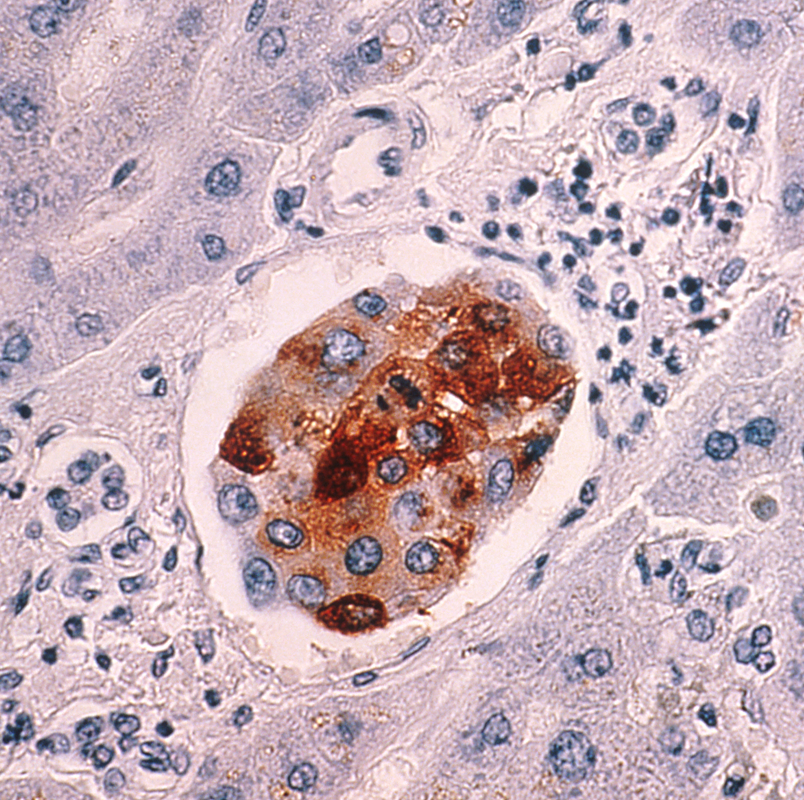
Background – Cancer Metastasis
Cancer is a leading cause of high mortality and costly healthcare Worldwide
In the US alone, it is estimated that 1,688,780 New Diagnoses of Cancer, and 600,920 Cancer Fatalities occur each year (according to American Cancer Society[www.cancer.org] )
This works out to ~5,000 New Cases per day ~1,650 Deaths per day
Metastasis is the most dangerous behavior of Tumors/Cancer
Many tumors are not life threatening, but present risk of Metastasis to Brain, Heart, etc
Notes:
Speaking Notes
References
National Cancer Institute. (2013). Retrieved from https://commons.wikimedia.org/wiki/File:Breast_cancer_metastasis_to_liver.jpg
Information and Resources about for Cancer: Breast, Colon, Lung, Prostate, Skin. (n.d.). Retrieved April
15, 2020, from https://www.cancer.org/

Slide 6
Background – Cancer Metastasis Cells Biology
When Cancer becomes Metastatic, Tumor cells enter the blood
Able to enter the blood by separating off a Primary Tumor
These cells are then known as Circulating Tumor Cells (CTC’s)
These cells then spread to other areas ; potentially taking root and a making a new tumor
By understanding properties of these CTC’s, blood tests may be performed to determine if a patient has cancer
Simulating these CTC’s and the blood flow around them can aid in the development of these tests, thus hopefully aiding the overall understanding of Cancer Metastasis and Development of Prevention and Detection Strategies.
Notes:
Speaking Notes
References
Diez-Silva, M., Dao, M., Han, J., Lim, C. T., & Suresh, S. (2010). Shape and Biomechanical Characteristics of Human Red Blood Cells in Health and Disease. MRS bulletin, 35(5), 382–388. https://doi.org/10.1557/mrs2010.571

Slide 7
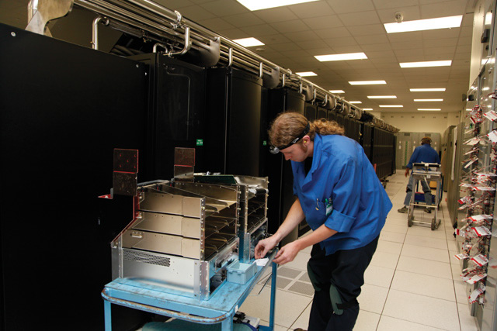
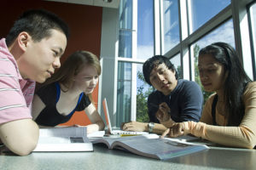
Background – Why Simulate Blood?
While making a model for any system an understanding is developed
This understanding may advance the knowledge of the field
Computers are also becoming more powerful at such a rate that simulating Complex Biological Systems is becoming possible.
Notes:
Speaking Notes
References:
Mcdaniel, R. (2012). Students Working. Retrieved from https://cft.vanderbilt.edu/2012/11/from-a-students-view-group-work/
Richards, J. (2012). Retrieved from https://en.wikipedia.org/wiki/Titan_(supercomputer)#/media/File:Cray_Technician_upgrading_
Titan.jpg

Slide 8
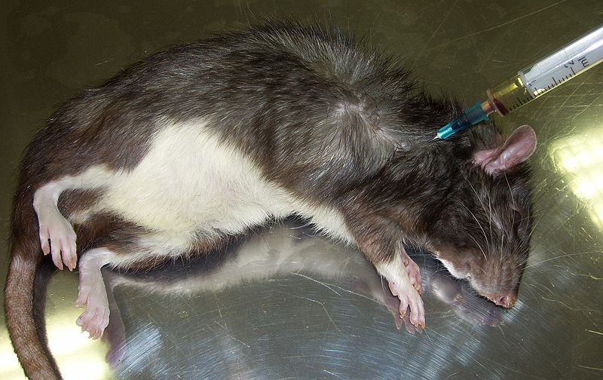
Background – Why Simulate Blood?
Studying these diseases Virtually would be clearly beneficial:
Pace of development may be improved
- Treatments may take days or weeks for patients to respond.
- Simulating has possibility of shortening this greatly
Avoids Human/Animal Testing
- While Clinical Trials will likely always require Human and Animal Subjects, if many experiments can be performed Virtually this reduces the harm caused to these living beings
Notes:
Speaking Notes
References
Gille, U. (2012). Retrieved from https://commons.wikimedia.org/wiki/File:Intracardial-injection-rat.JPG

Slide 9

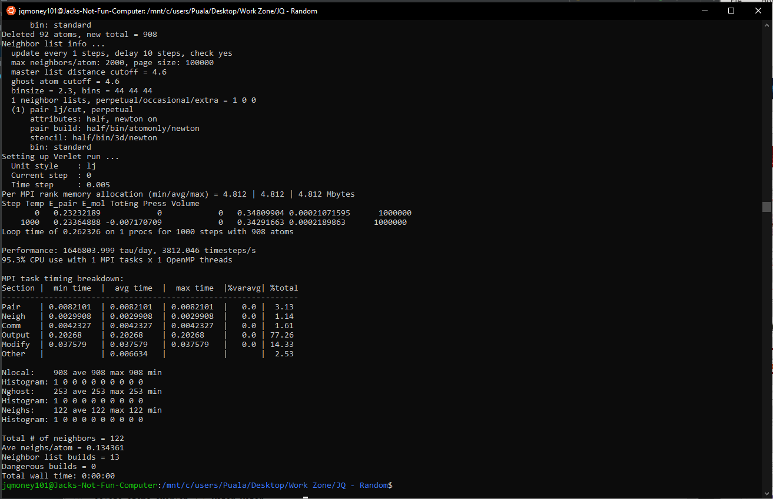
Background – Ubuntu
To Compile and Run LAMMPS the Ubuntu Operating System was used
This is an Open Source “Shell” Operating System that is Run using a Linux Kernel and based on Debian ( see Ubuntu.com for more info )
Is far less feature rich than Windows but is helpful due to its open source nature and simplicity
Allows for easier software development
In my case I ran it as a “Shell”
This means that Ubuntu ran alongside Windows
Notes:
Speaking Notes
-Now for background on other software used
References
Canonical Ubuntu 18.04 LTS (2020, February 12). Retrieved from https://ubuntu.com/
https://commons.wikimedia.org/wiki/File:Ubuntu_logo_orange.png
ubuntu terminal image was produced by me, available in github repository

Slide 10

Background – Python / PyCharm
Python is a widely used Open Source Programming Language
It is object oriented but can be added to with many tools
Easy to learn
Link - https://www.python.org/about/
Editor used – PyCharm
To write and edit Python Codes need an editor and a way to execute code
PyCharm provides both in a user-friendly package
Link - https://www.jetbrains.com/pycharm/whatsnew/
Notes:
Speaking Notes
References
Python
Python Software Foundation. (2020). Welcome to Python.org. Retrieved April 16, 2020, from
https://www.python.org/about/
PyCharm
JetBrains s.r.o. (2020). PyCharm. Retrieved April 17, 2020, from
https://www.jetbrains.com/pycharm/whatsnew/

Slide 11
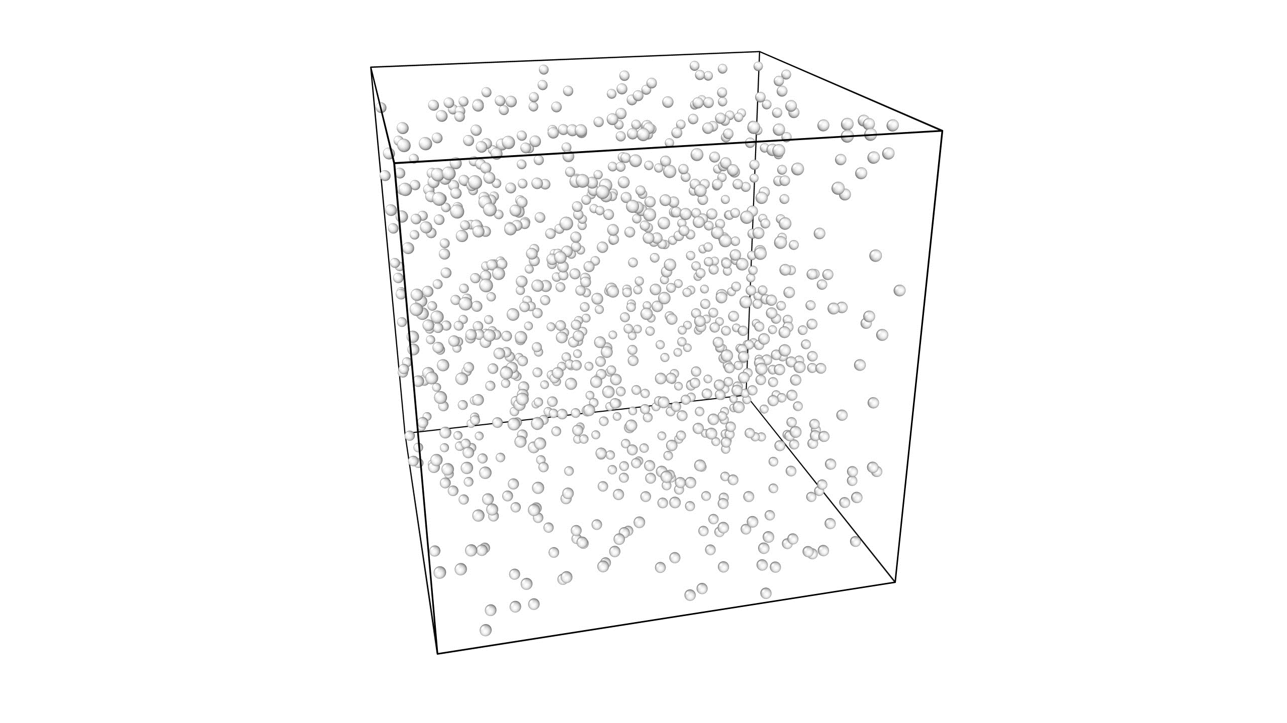
Background – Ovito – Open Visualization Tool
An Open Source, Scientific Visualization and Analysis Tool
Link - https://www.ovito.org/
Used Primarily to process the .dump files from LAMMPS
Can convert .dump files (if configured correct) into:
Images ( .jpg , .png )
Videos (.gif , .mp4 )
Notes:
Speaking Notes
References
Video was produced by me, available in github repository
Stukowski, A. (2020). Ovito. Retrieved April 17, 2020, from https://www.ovito.org/

Slide 12
How to Simulate – Program Choice
Lots of Different Programs for Simulating Bio-Molecules
Avogadro – More Specialized as a Molecular Editor ; Can run Min Simulations
Link - https://avogadro.cc/
CHARMM – A Molecular Dynamics Package; includes CHARMM force fields
CHARMM force fields used widely by other software, while package is less used
Link - https://www.charmm.org/
Materials Studio – Similar to Other MD codes , for Commercial use
Non–Open Source , Optimized for Cluster Computing
Link - https://www.3dsbiovia.com/products/collaborative-science/biovia-materials-studio/
Notes:
References
Avogadro
Avogadro Chemistry. (2018). Free cross-platform molecular editor. Retrieved April 16, 2020, from https://avogadro.cc/
CHARMM
Karplus, M. (2020). CHARMM (Chemistry at HARvard Macromolecular Mechanics). Retrieved April 16, 2020, from https://www.charmm.org/
Materials Studio
BIOVIA. (2020). Materials Studio Overview. Retrieved April 16, 2020, from https://www.3dsbiovia.com/products/collaborative-science/biovia-materials-studio/

Slide 13
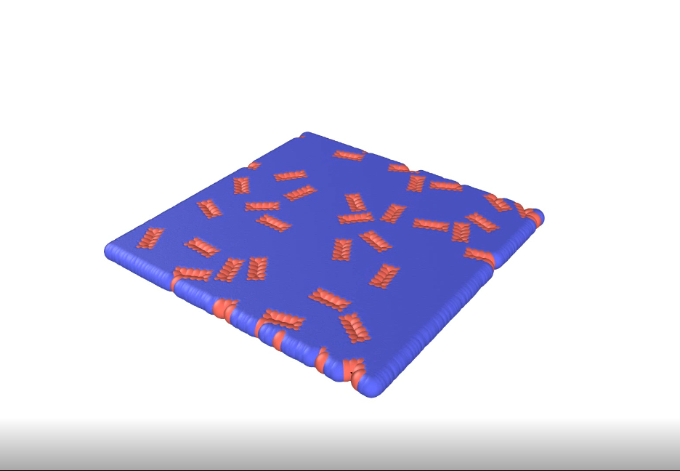
Background – LAMMPS - Intro (Large-scale Atomic/Molecular Massively Parallel Simulator)
My Choice for Molecular Dynamics Simulator LAMMPS
A Molecular Dynamics code focusing on Materials Modeling
Can Simulate Materials Down to the Atom Level
Open Source; Well Documented ; Lots of User Support
Primary Focused On Materials Engineering
Growing BioMolocules Support
Built-In Hardware Acceleration (Multi-Threading and GPU Support)
Link to LAMMPS : https://lammps.sandia.gov/
Chose because support is very good, and Professor Dabagh Suggested it
A Simple 2-D Simulation With Large Box Particles (Red) and Small Solvent Particles (Blue
Notes:
Speaking Notes
- Chose Lammps because Very open source and professor suggested
References
LAMMPS
https://lammps.sandia.gov/
Simulation image was produced by me, available in github repository

Slide 14
LAMMPS – Process Overview - Intro
Main Steps of Simulating Using LAMMPS
Create Simulation – This can be done a few ways ; in this presentation I will show how to specify initial geometry using Python Scripting
Run Simulation – To Run Created Simulation must make sure “environment” around simulation is setup correctly
Process the Results - Analyze the data produced by the Simulation to produce Graphs, Tables, Images, or Videos.

Slide 15
Background – Process Overview
The “Workflow” for a LAMMPS Simulation is as Shown below
3 Main Sections as described from previous slide ; As well as Idea and Outputs
Blue = Create Simulation Red = Run Simulation
Purple = Process Results Green = Outputs/Data
Idea
Python Script
LAMMPS Data File
LAMMPS Input File
LAMMPS
Ovito
LAMMPS .dump Files
Images Videos
Notes:
References

Slide 16
LAMMPS – Overview – Create Simulation
To Create a LAMMPS Simulation there are 2 Main “Routes”
1 – Use ONLY a LAMMPS Input File (in.filename)
2 – Within the Input File read data from an external file to Specify several Variables ( Simulation Space, Particle Positions, Bonds between Particles, etc.)
In this presentation this method will be shown

Slide 17
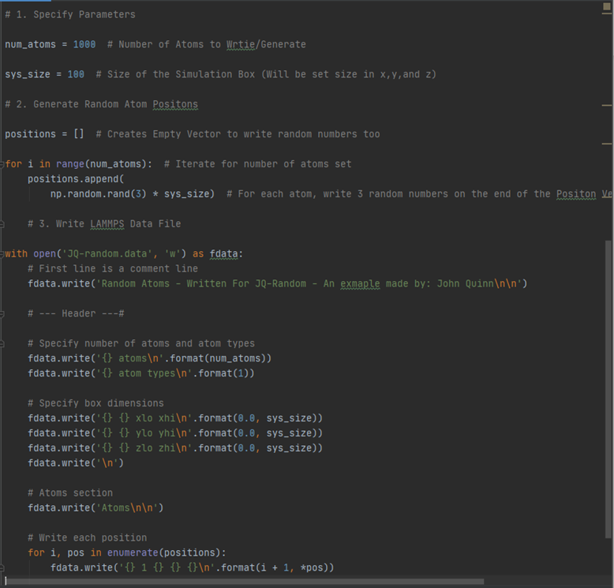
LAMMPS – Create Data File
LAMMPS Data files are .txt style files that follow a format laid out by the LAMMPS Developers at: https://lammps.sandia.gov/
Following this format the Python Script JQ-random.py was made
Very Simple Python Code
Assigns Random Positions to Each “Atom”
Then writes the .data file following the LAMMPS format and inserting the generated Simulation data where needed
Notes:
Speaking Notes
Refrences

Slide 18
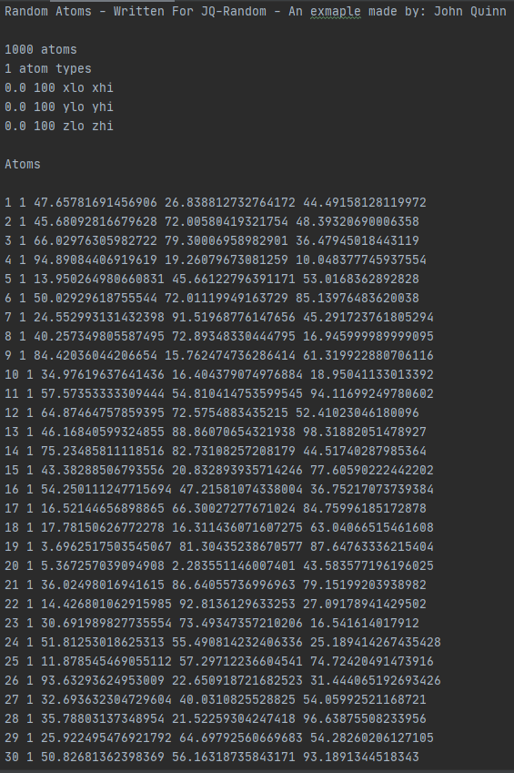
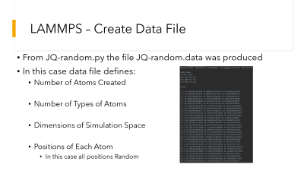
LAMMPS – Create Data File
From JQ-random.py the file JQ-random.data was produced
In this case data file defines:
Number of Atoms Created
Number of Types of Atoms
Dimensions of Simulation Space
Positions of Each Atom
In this case all positions Random
Notes:
Speaking Notes
Refrences

Slide 19
LAMMPS – Create Input File
Once the Data File in generated the next step is to setup the rest of the Simulation Parameters within the Input File
Format given by LAMMPS team: ( LINK TO INPUT FILE URL)
There are many Parameters Set by the Input File . . .
So only the most important commands and parameters will be presented
For more information regarding the input file refer to the LAMMPS Documentation

Slide 20
LAMMPS – Important Input Parameters
GO thru input file and explain important commnds
Go into math/science of more involved ones (ex pair_coeff)

Slide 21
Running Simulation – JQ-Random
Show input command for ubuntu and the terminal during/after execution

Slide 22
Background – LAMMPS – Visualization (OVITO)
Show how OVITO is used to post process lammps data into images and movies

Slide 23
RBC SIMULATION
Show creating geometry
Show input file
Show sim time/system performance
Show videos and images from ovito
Show charistic behavoris to compare to cancer

Slide 24
CANCER METASTASIS SIM
Show creating geometry
Show input file – differentiate cancer cells by making cytoskeleton stronger; simulates the much more rigid cell could also make bigger b/c seems they are bigger
Look at papers for information
Show sim time/system performance
Show videos and images from ovito
Show charistic behavoris to compare to RBC

Slide 25
Possible Future Developments
Detection sim?
Some sort of sim to show how properties of Cancer and RBC can be used to sort them?
PAD Sim?
If models for blood vessel walls and blockage model can be produced could study PAD
Sepsis Sim?
Maybe the cell-cell interactions maybe modeled with further study and work

Slide 26
References and Acknowledgements
References

